Slide 1
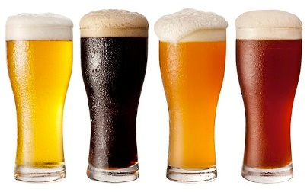
Unit 8 Project
EDA: Hao Wang
This Photo by Unknown Author is licensed under CC BY-SA

Slide 2

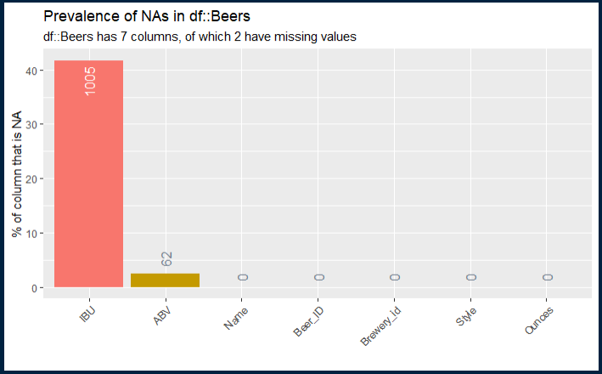
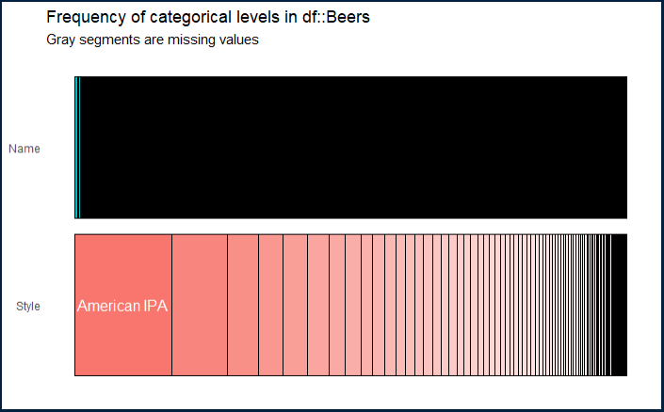
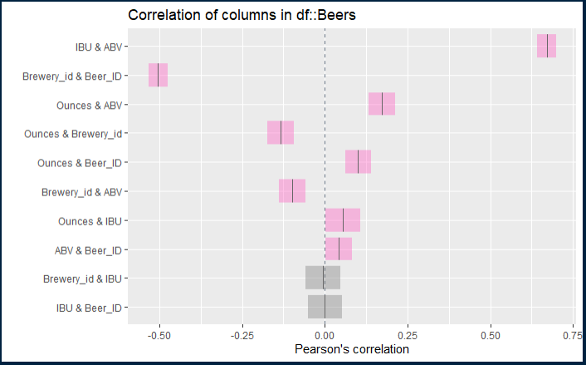
INITIAL DATA PROFILING BEER DATA SET
Beers data set: 2410 observations, 7 variables.
2 factors: Name & Style
3 integers: Beer ID, IBU & Brewery ID
2 numeric: ABV & Ounces
Missing Values:
IBU: 1005 observations (42%)
ABV: 62 observations (3%)
Missing values will be replaced with median.
Unique Values:
Beer Name: 2305 unique values and 105 duplicates.
Beer Style: 100 unique values

Slide 3
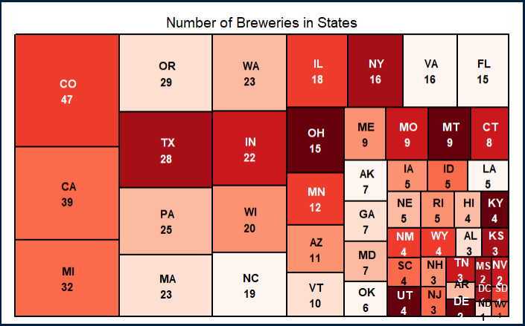
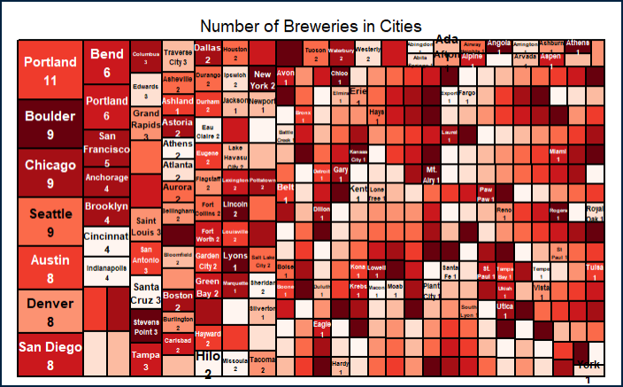
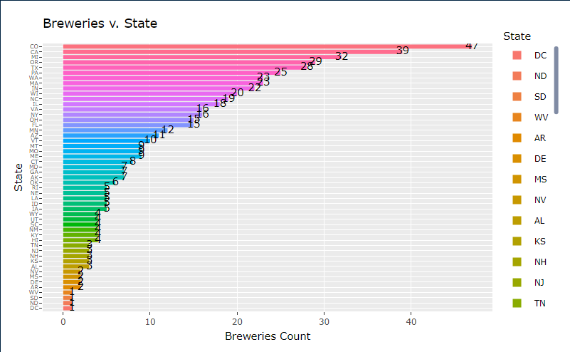
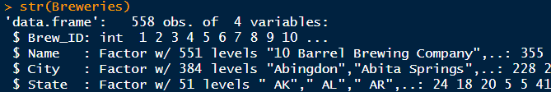
INITIAL DATA PROFILING BREWERY DATA SET
Brewery data set: 558 observations, 4 variables.
No missing values

Slide 4
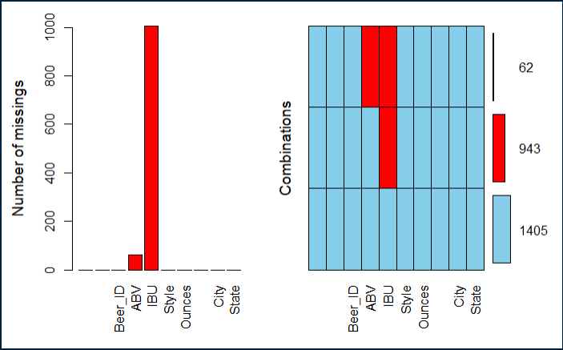
INITIAL DATA PROFILING MISSING VALUES IN MERGED DATA SET
Missing values:
62 NA’s for both ABV and IBU
1005 NA’s for IBU only
Dealing with missing values:
Replace 62 NA’s in ABV with state level median
Replace 1005 NA’s in IBU with predicted values from simple linear regression model.
# Original data excluding NA’s:
Pearson's product-moment correlation
t = 33.863, df = 1403, p-value < 2.2e-16
95 percent confidence interval:0.6407982 0.6984238
sample estimates: cor 0.6706215
# Data with NA’s replaced by state median:
Pearson's product-moment correlation
t = 27.516, df = 2408, p-value < 2.2e-16
95 percent confidence interval:0.4581154 0.5188919
sample estimates: cor 0.4890971
-18%
Simply replacing missing values in IBU/ABV with state median results in significant drop on correlation, from 67% to 49%
Alternative option is to use Simple Linear Regression model to predict IBU missing values, to keep the correlation between IBU/ABV no change.

Slide 5
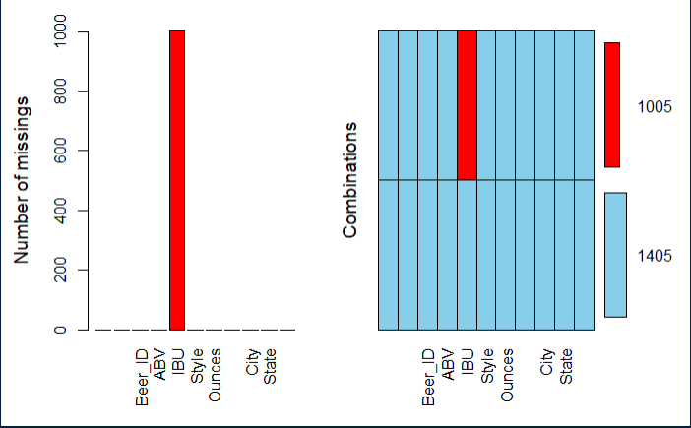
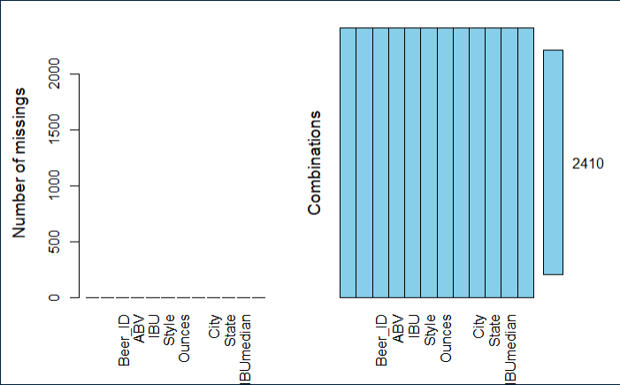
INITIAL DATA PROFILING MISSING VALUES IN MERGED DATA SET
Dealing with missing values:
State median to replace 62 NA’s in ABV
Dealing with missing values:
Predicted values from Simple Linear Regression model to replace 1005 NA’s for IBU.
Simple Linear Regression:
IBU = Intercept + Slope*ABV
= -34.09865 + 1282.037 * ABV
# Data with NA’s replaced by state median:
Pearson's product-moment correlation
t = 57.005, df = 2408, p-value < 2.2e-16
95 percent confidence interval:0.7403535 0.7743731
sample estimates: cor 0.757878

Slide 6
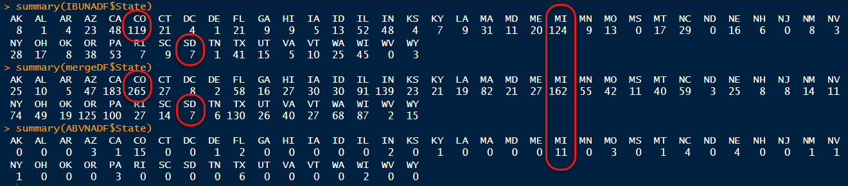
INITIAL DATA PROFILING MISSING VALUES IN MERGED SET (Cont.)
Plan to use median value of each state to replace NA’s in IBU or ABV
Only one state (SD) do not have median value due to NA
100% IBU value are NA in state SD (7 out of 7)
76% IBU value are NA in state MI (124 out of 162)
45% IBU value are NA in state CO (119 out of 265)

Slide 7
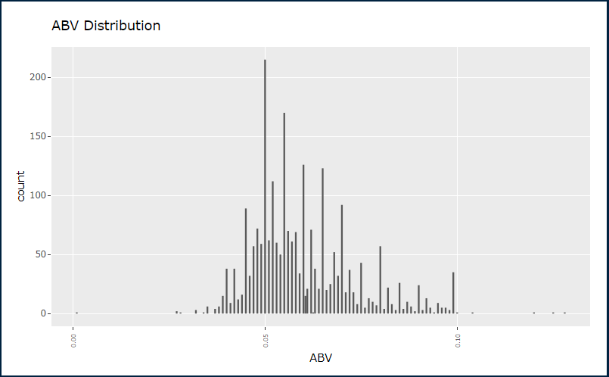
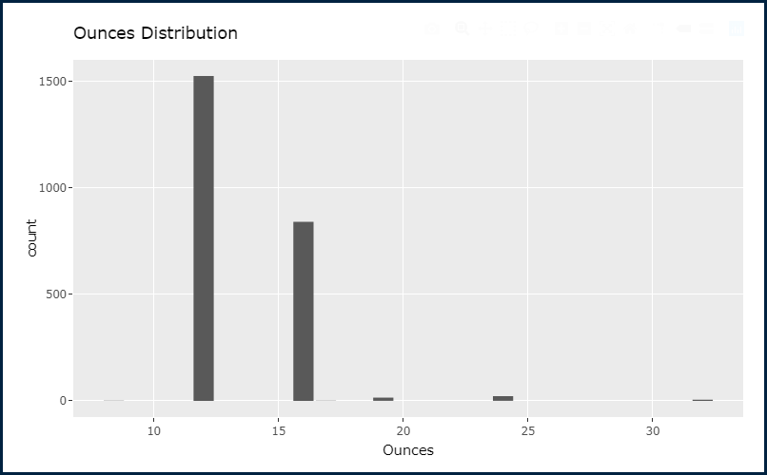
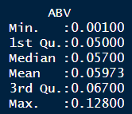
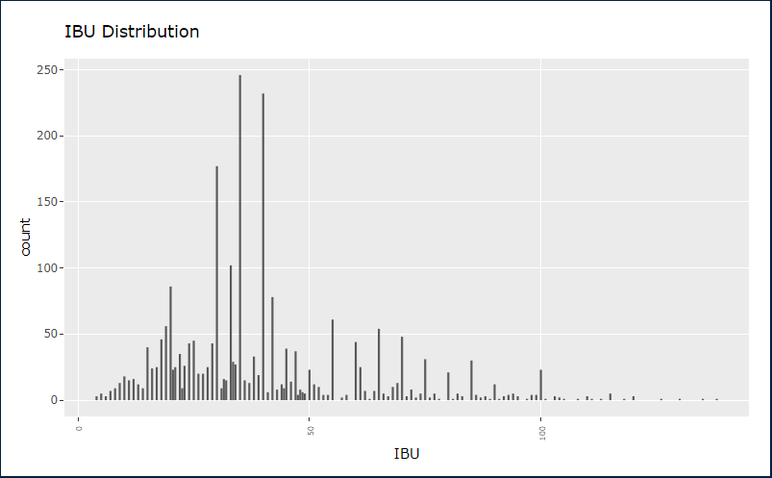
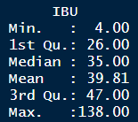
INITIAL DATA PROFILING mergeDF DATA SET

Slide 8
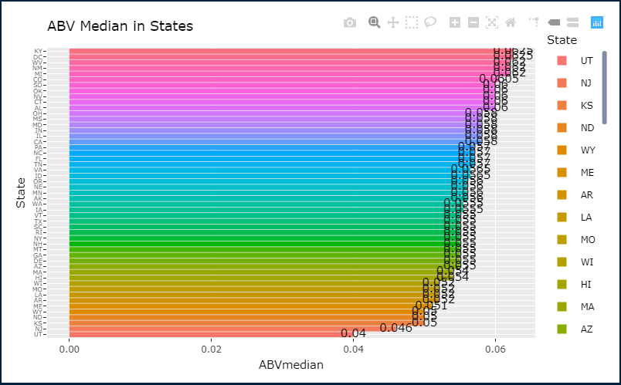
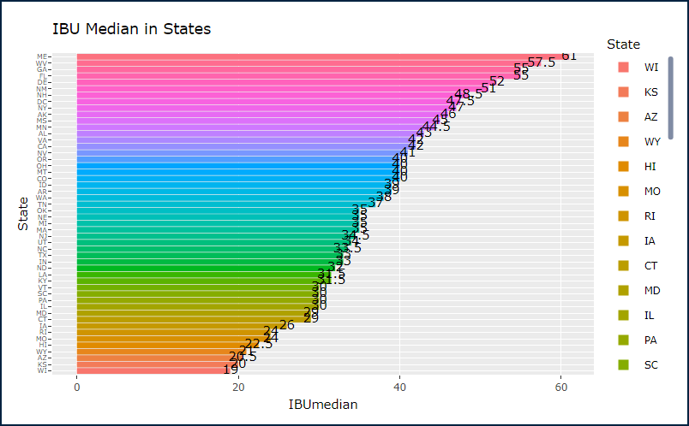
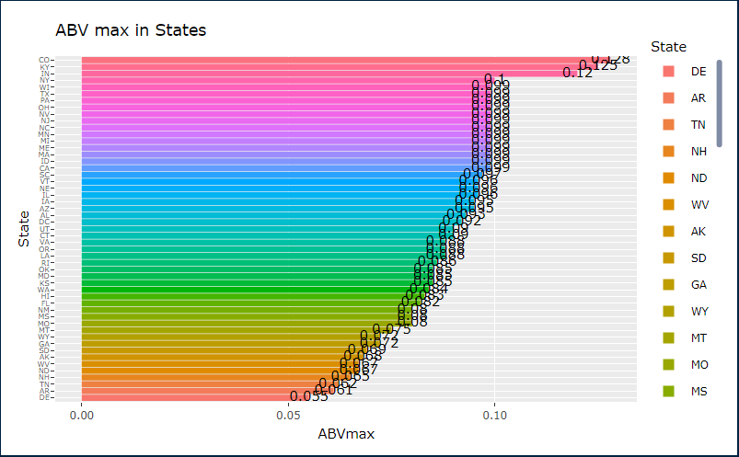
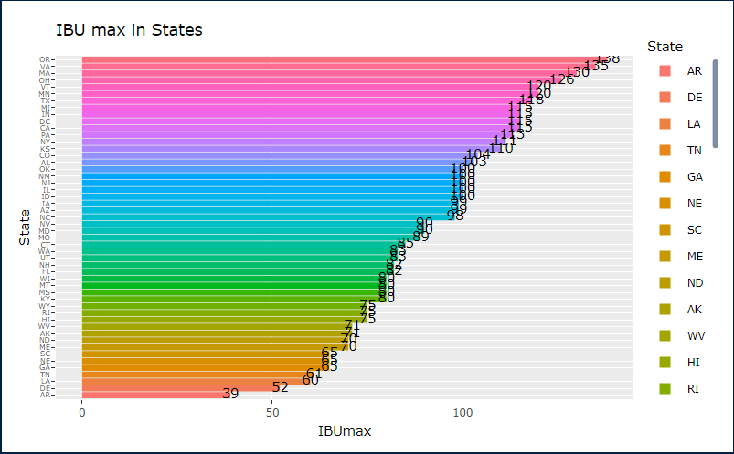
MEDIAN AND MAX ABV/IBU IN EACH STATE

Slide 9
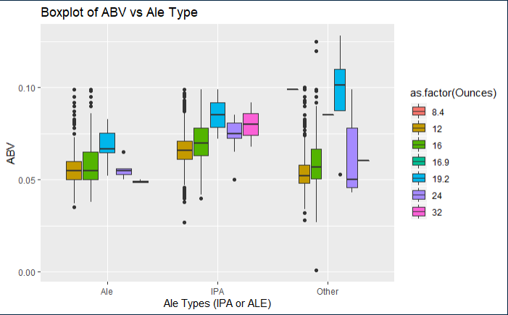
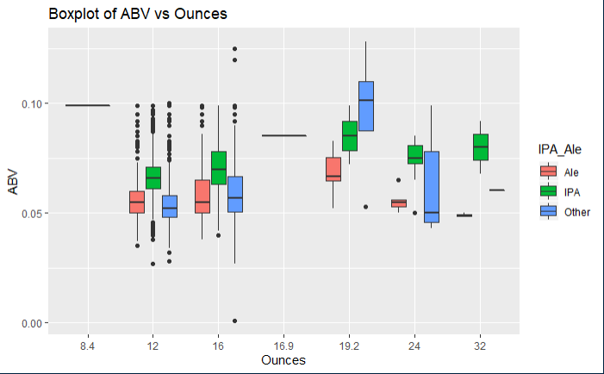
STATISTICS and DISTRIBUTION OF ABV

Slide 10
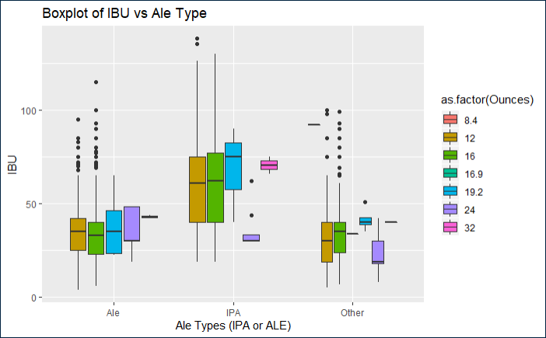
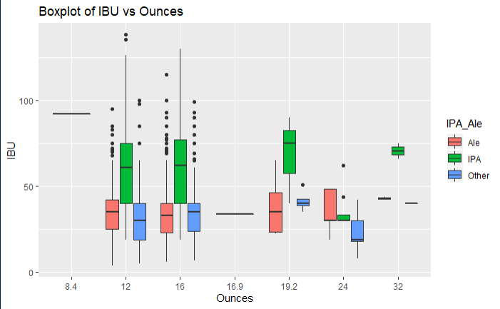
STATISTICS and DISTRIBUTION OF IBU

Slide 11
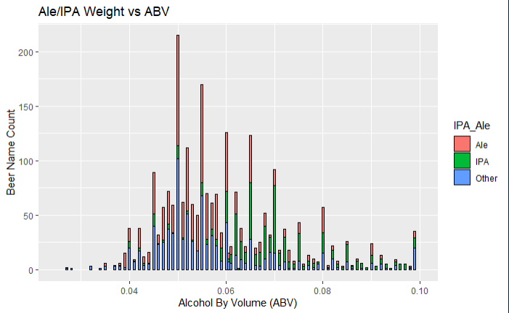
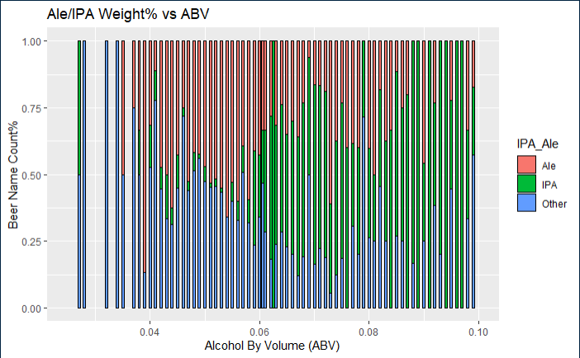
STATISTICS and DISTRIBUTION OF ABV
IPA beer weight ~30% of total when ABV > 0.06
IPA beer weight very small amount when ABV < 0.06
Why ?

Slide 12
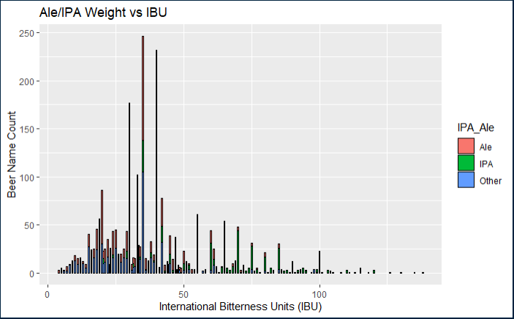
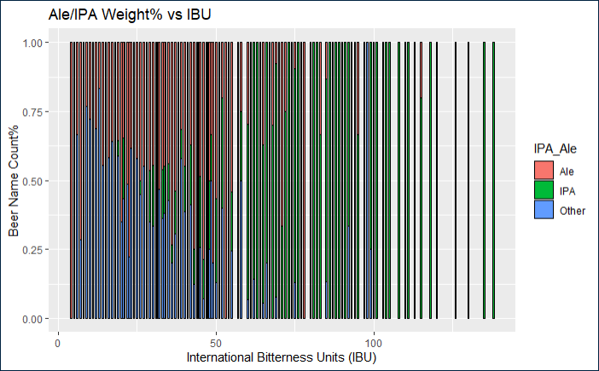
STATISTICS and DISTRIBUTION OF IBU
IPA beer weight ~80% of total when IBU > 50
IPA beer weight very small amount when IBU < 50
Why ?

Slide 13
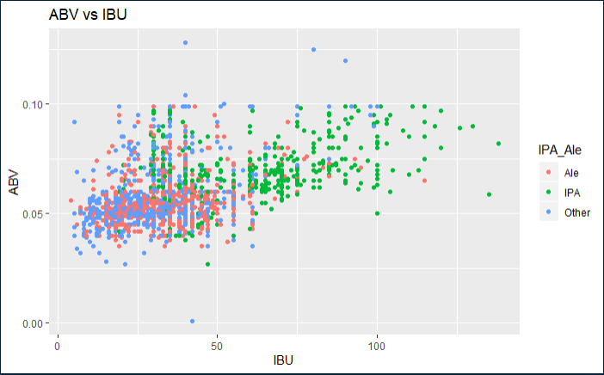
STATISTICS and DISTRIBUTION OF ABV & IBU

Slide 14
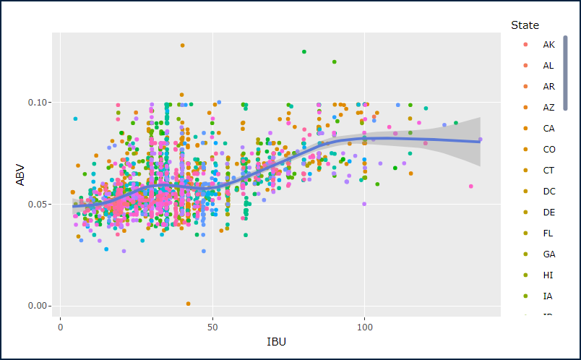
RELATIONSHIP ABV v. IBU

Slide 15
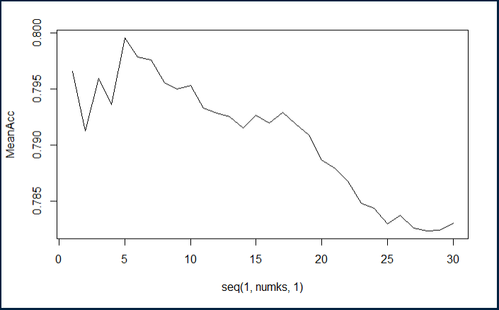
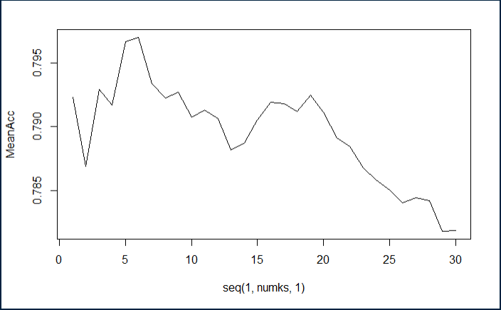
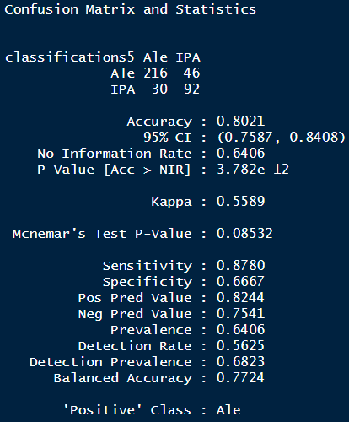
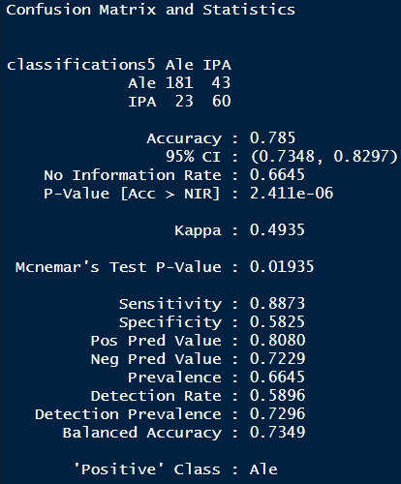
KNN CLUSTERING: IBU&ABV FOR IPAs v. Other Ale
splitPerc = .75
iterations = 50
numks = 30
K = 5
splitPerc = .80
iterations = 50
numks = 30
K = 6

